Slide 1
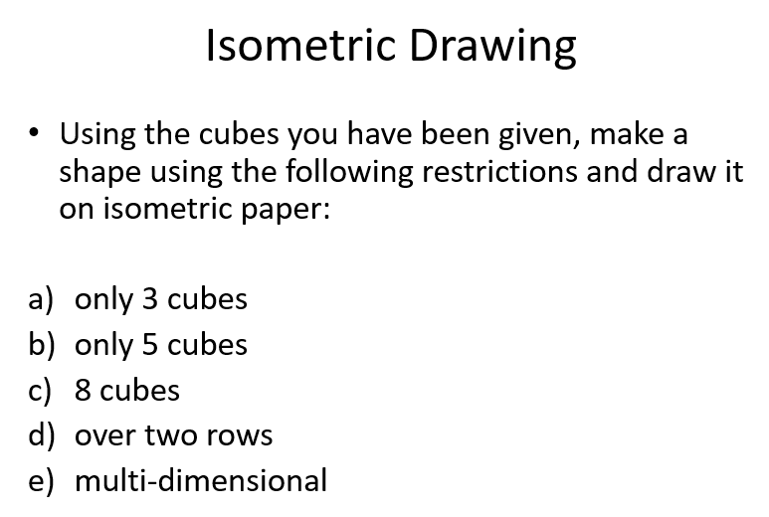
24
7
30
Topic: Isometric drawings
Date
EQ: How do I use isometric paper to draw solids?
Practice:

Slide 2
